Slide 1

Final Presentation Innovation Project
Group 4
Austin Kuhlman Trenton Wood

Slide 2


Recommendations Overview
Recommendations Report
Borden Dairy
Stop the use of plastic milk jugs
Rhetorical Situation
Audience Analysis
Contexts of Use and Production
Headings and Subheadings
Using questions as headings

Slide 3
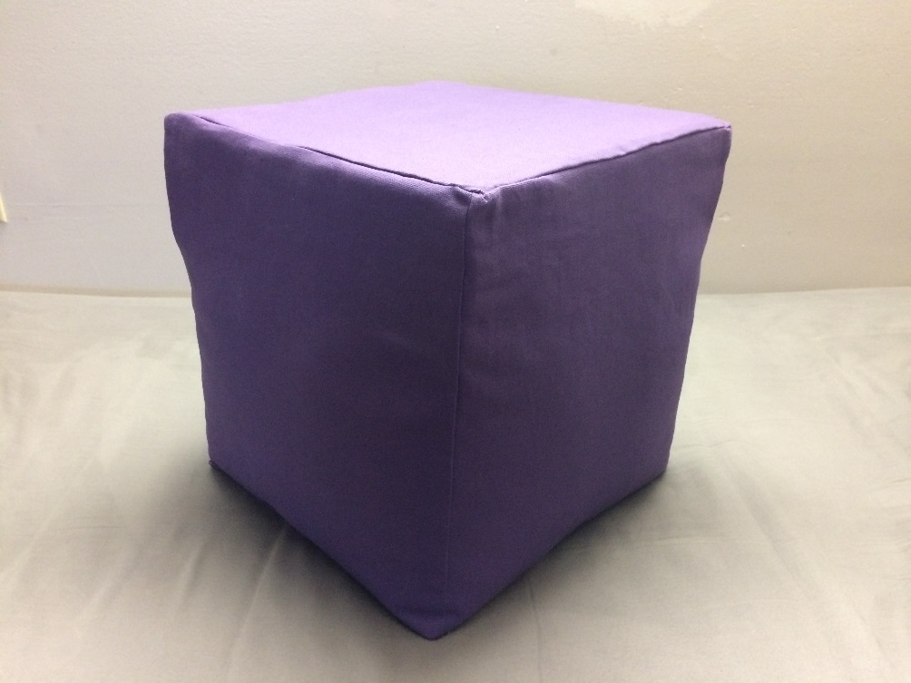
DIY Overview
DIY Webpage
Create an ottoman out of plastic bottles
Audience Analysis
Technical Illustration
Logical Chunks
Technical Definition and Description

Slide 4
Rhetorical Situation
Audience:
Borden Dairy Consumer Care
Purpose:
Consider the impacts of plastic in our world
Action:
Switch from plastic to glass milk bottles

Slide 5
Audience Analysis
“Carlos” Consumer Care Representative
Thinks about Borden’s image
Evaluates customer desires
Is this option feasible?
Easy to summarize for boss

Slide 6

Contexts of Production and Use
Production
Two students of ENGL 302
Secondary Audience – Ms. Salter
Tertiary Audience – K-State Administration
We are representing K-State
Make valid argument with researched sources
Use
Primary – “Carlos”
Secondary – Managers and Department Heads
Tertiary – Media which may receive report
Milk Experts
Issues with packaging should be well known

Slide 7
Headings and Subheadings
Create sections in report
Ease of Reading
Questions as Headings
Help to guide readers thoughts
Make the document easy to scan

Slide 8

DIY Project – Audience Analysis
People who use plastic bottles
Care about their environment
Want to have fun
Crafty – Use of sewing machine

Slide 9
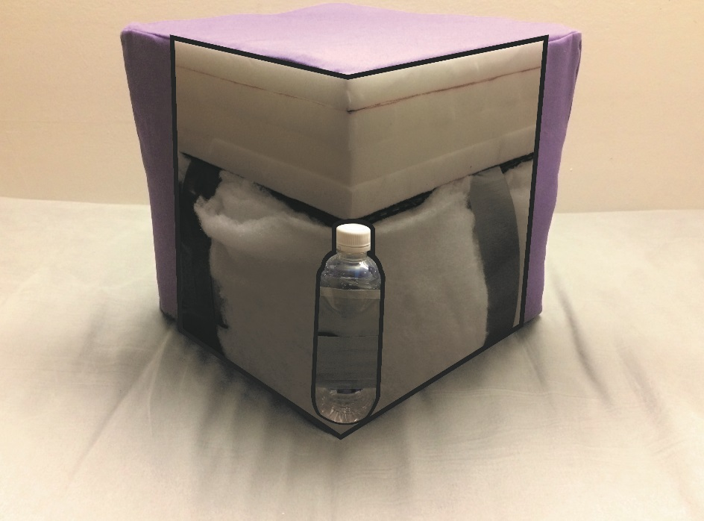
Technical Illustration
Create a model showing layers
Adobe Illustrator
Cut away outside
Help to demonstrate assembly

Slide 10
Logical Chunks
Introduction
Materials
Base
Cover
Technical Illustration
Conclusion

Slide 11
Technical Definition and Description
Parenthetical (Inside of parenthesis) Phrases
Bullet Description
Illustrate more clearly tasks
Label Images with description

Slide 12
Conclusion
Recommendations Report to Borden
DIY Ottoman
Any Questions?

